Slide 1

Why Paid UI Components Aren’t Evil
@tjvantoll
❌
👿

Slide 2
🥳
🎂
🎉
🍰
Almost all software we use on the front end today is free
🍰
🎂
🎉
🥳

Slide 3


Slide 4


💰
💰
💰
💰
💰
💰
💰
💰
💰
💰
💰
💰
💰
💰
💰

Slide 5

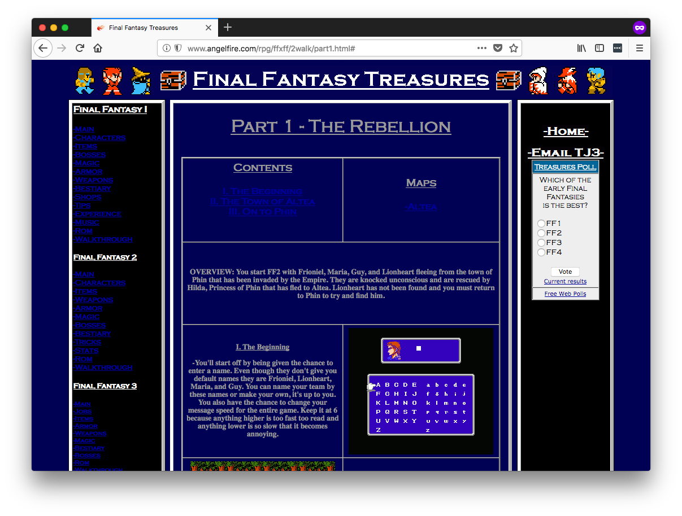
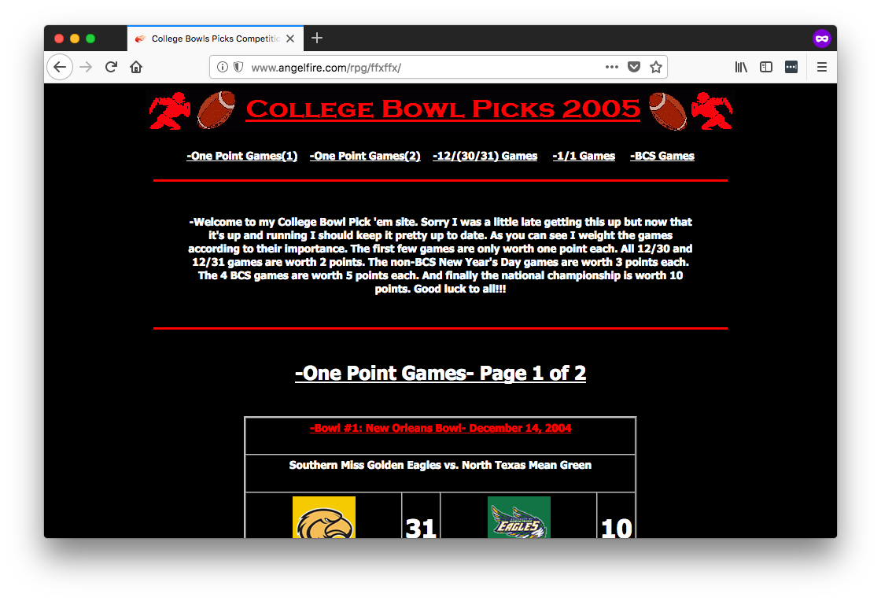
Actual web sites I built

Slide 6


Slide 7

Notes:
For the last few years though I’ve worked for a company called Progress, and worked on a UI component suite called KendoReact.
And, importantly for this talk, we charge money for our controls.
And having worked for free and paid UI components have given a whole different perspective.

Slide 8
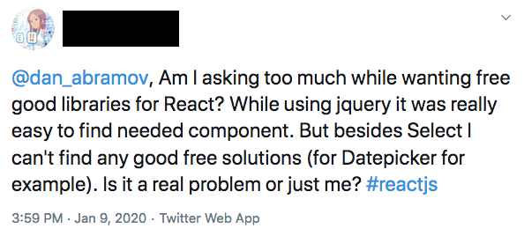

Slide 9
Reasons to consider paid UI components
1) Guaranteed support
2) Long term piece of mind
3) Solving harder problems
4) More sane funding model

Slide 10
1) Guaranteed support
Notes:
The help you receive depends on how willing the community is to devote their time.

Slide 11
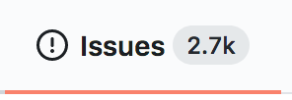

Slide 12
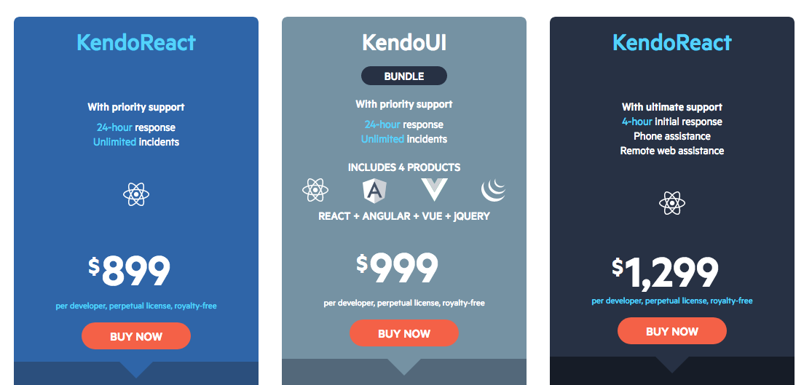

Slide 13
2) Long-term piece of mind
Notes:
Another problem with free UI tools is there’s no real incentive for authors to continue maintaining their projects after their motivation to work on the thing goes away.

Slide 14

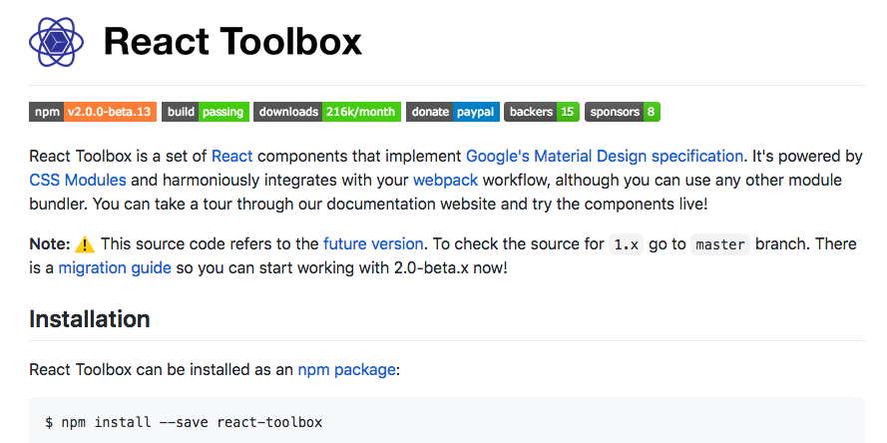
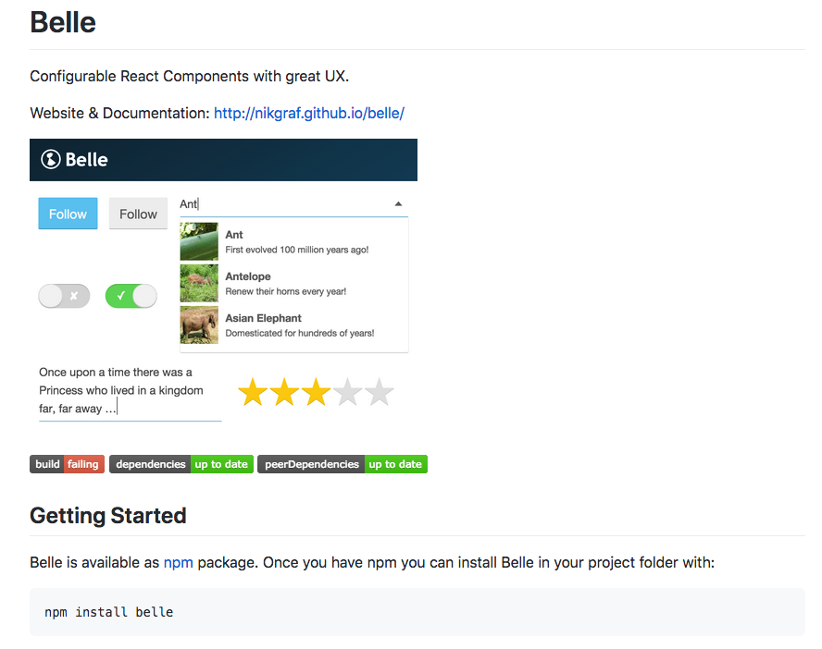

Slide 15
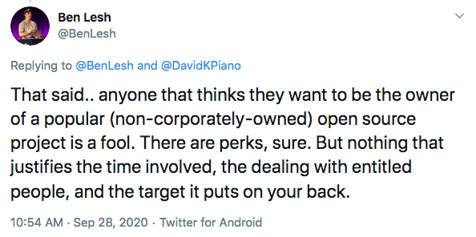
Notes:
A direct financial relationship that isn’t as dependent on the author’s motivation or goodwill

Slide 16
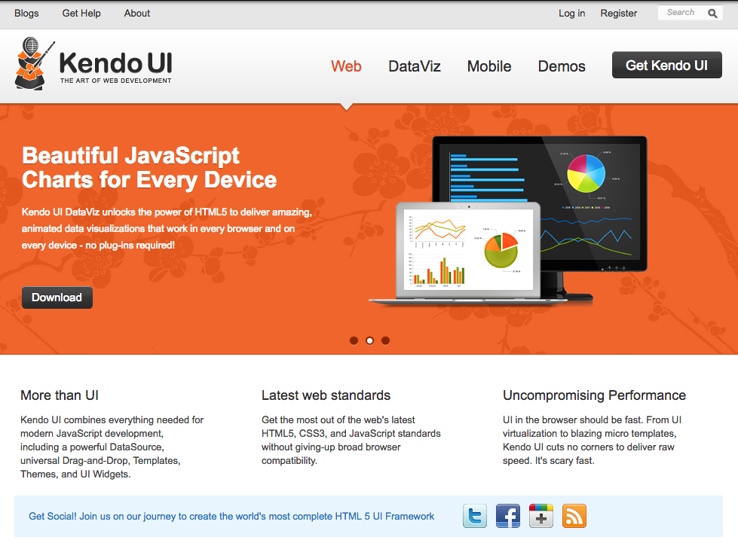
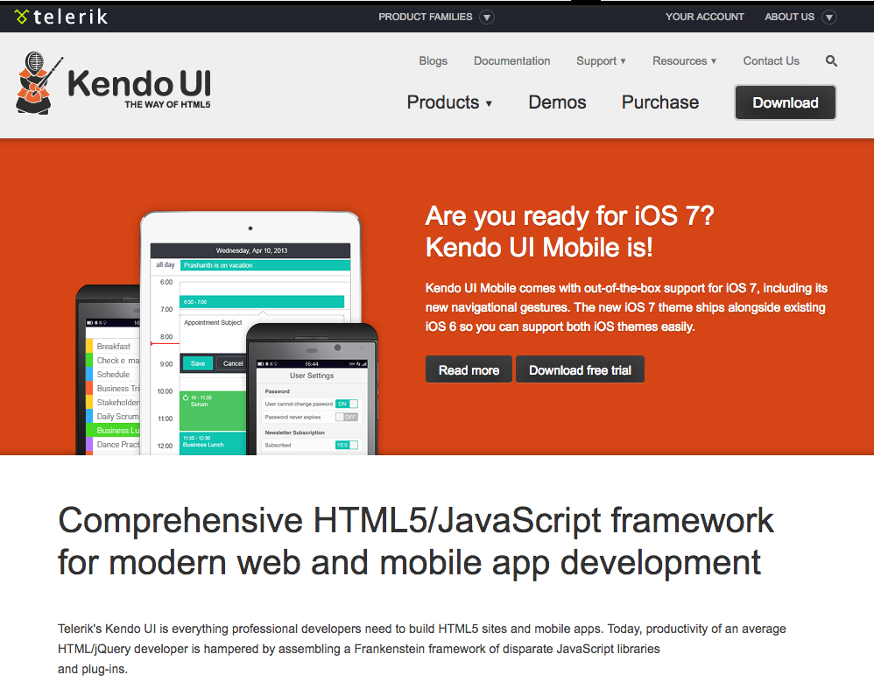
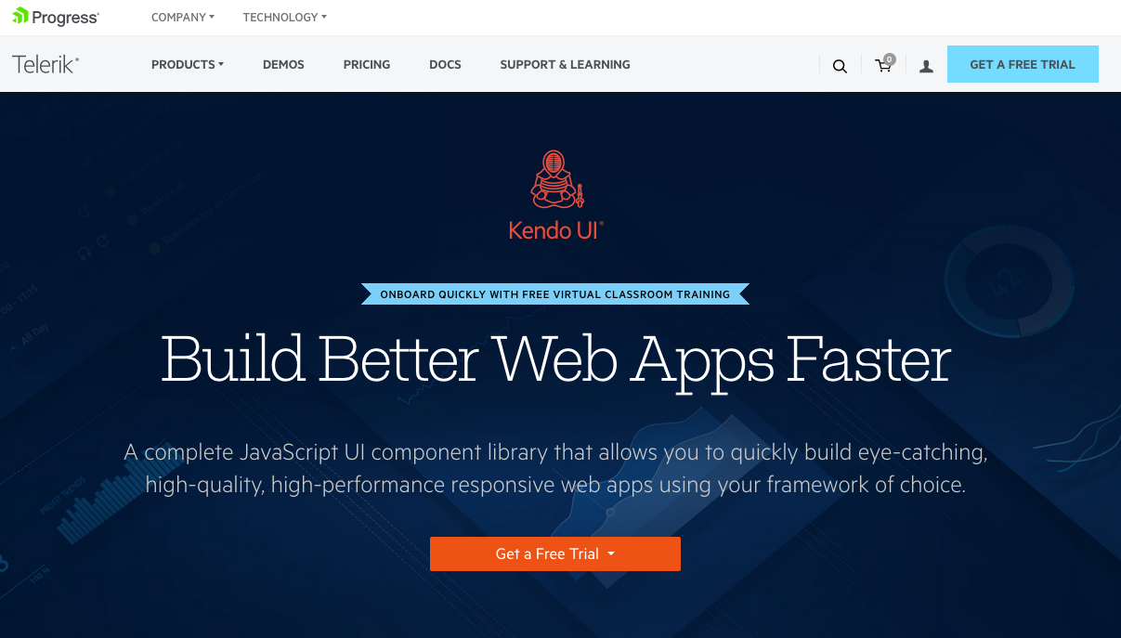
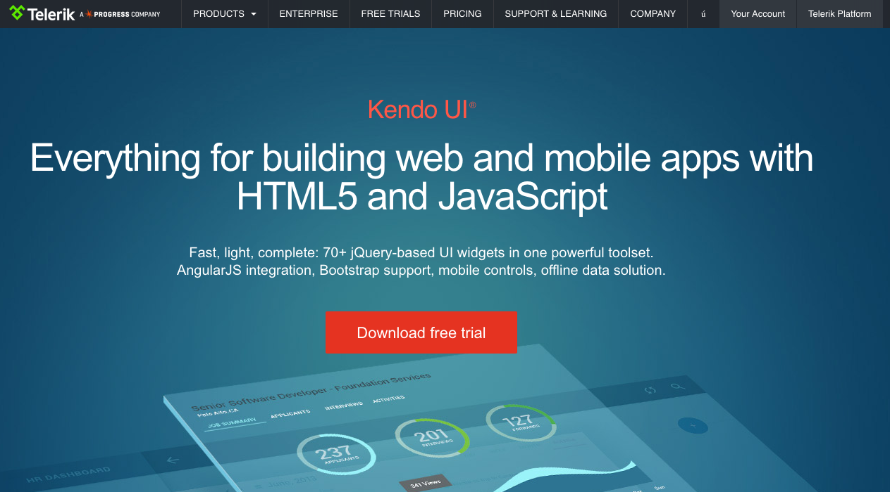
2011
2013
2015
2017

Slide 17
3) Solving harder problems
Notes:
A lot of developers competing to make the best React datepicker

Slide 18
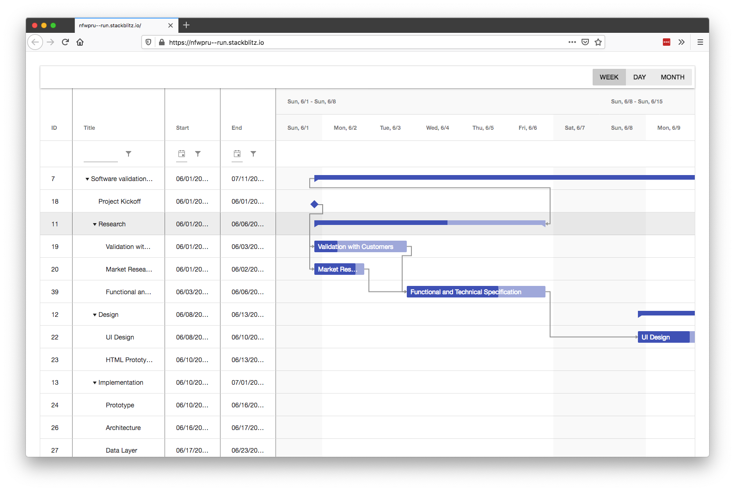

Slide 19
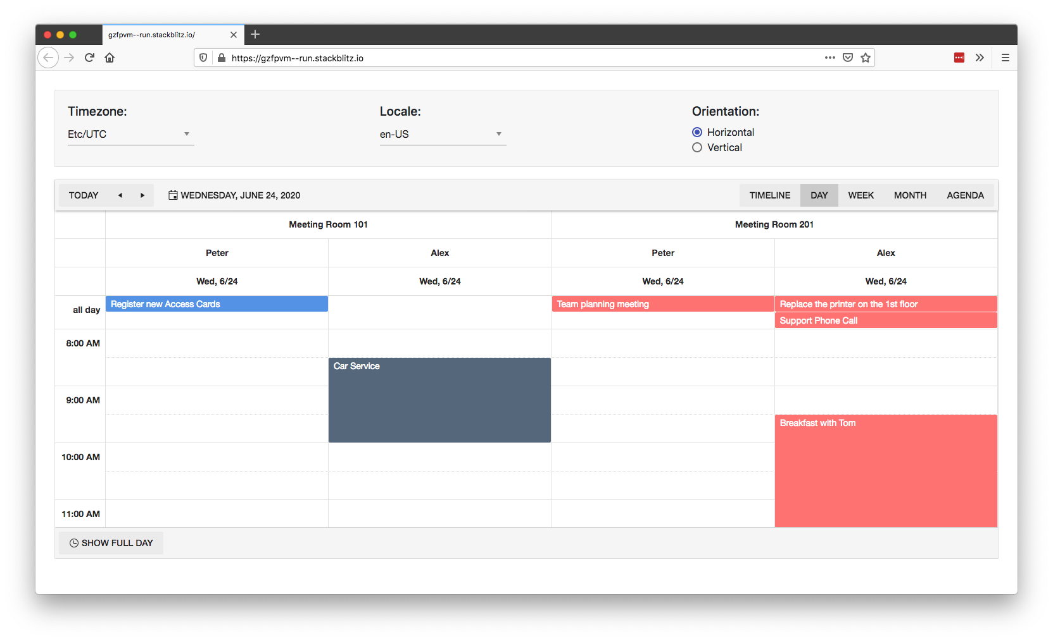

Slide 20
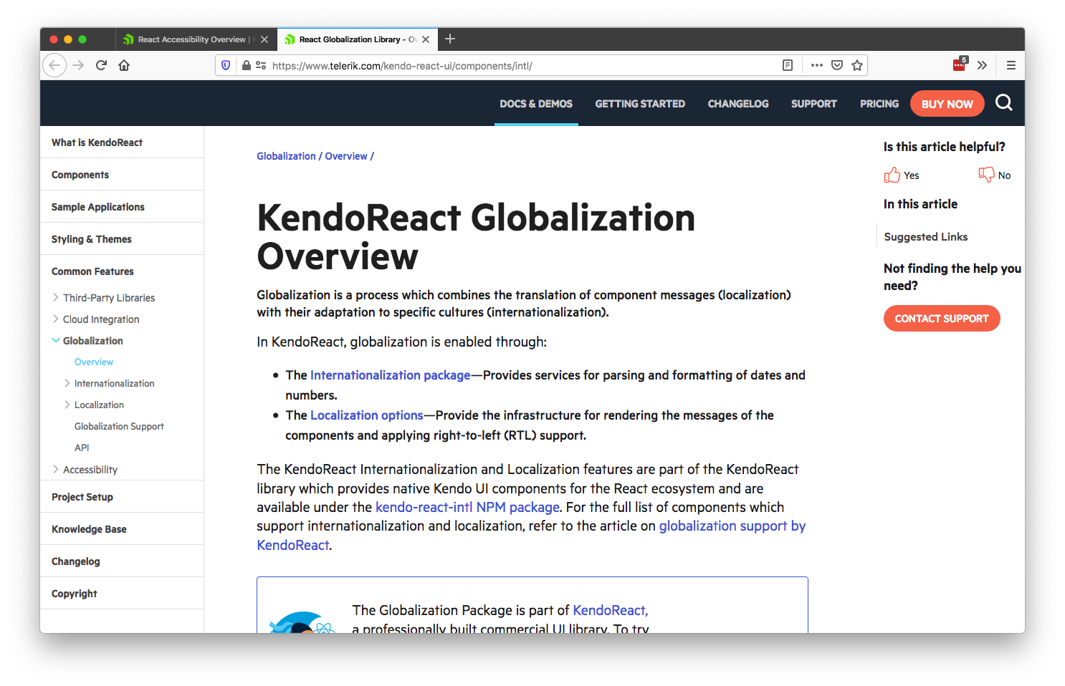
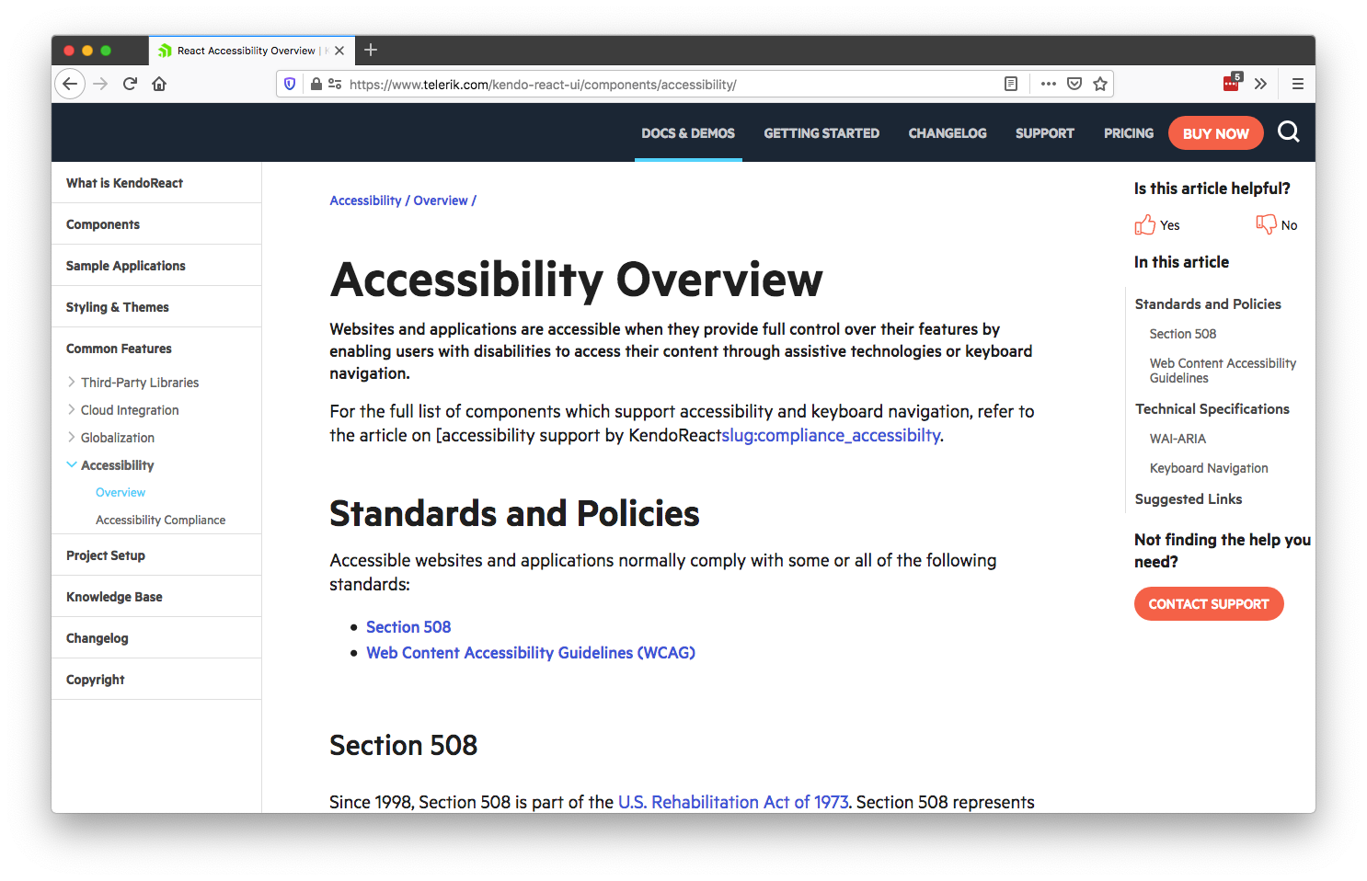
Notes:
We spend a lot of time making sure all our components meet numerous accessibility standards

Slide 21
4) Sane funding model
Notes:
Because in today’s front-end world

Slide 22
≠
Value of free front-end software
Amount developers are compensated

Slide 23
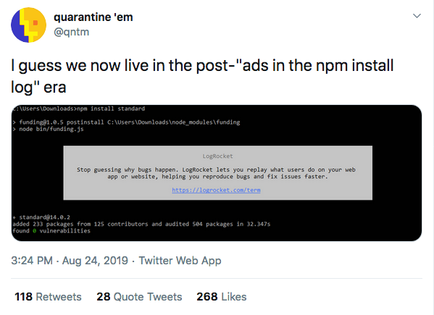

Slide 24
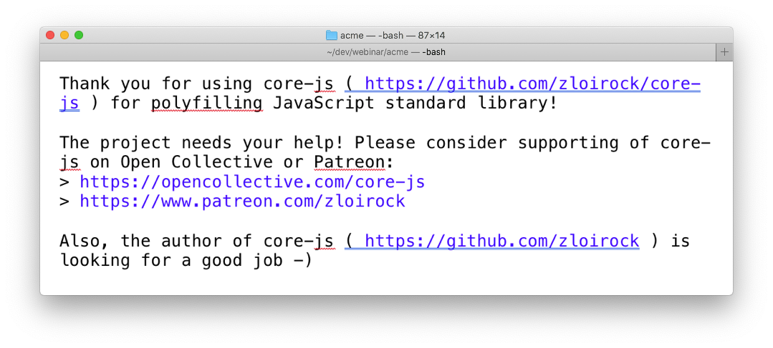

Slide 25
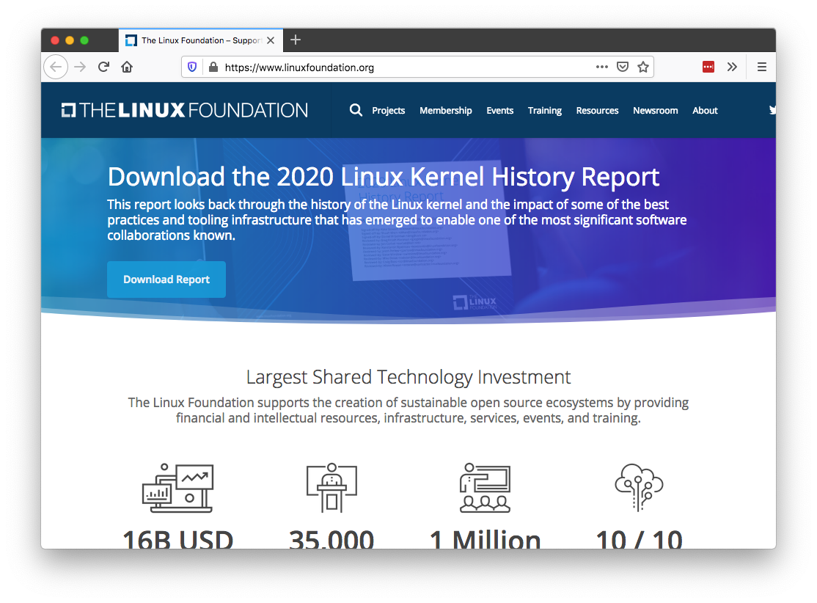
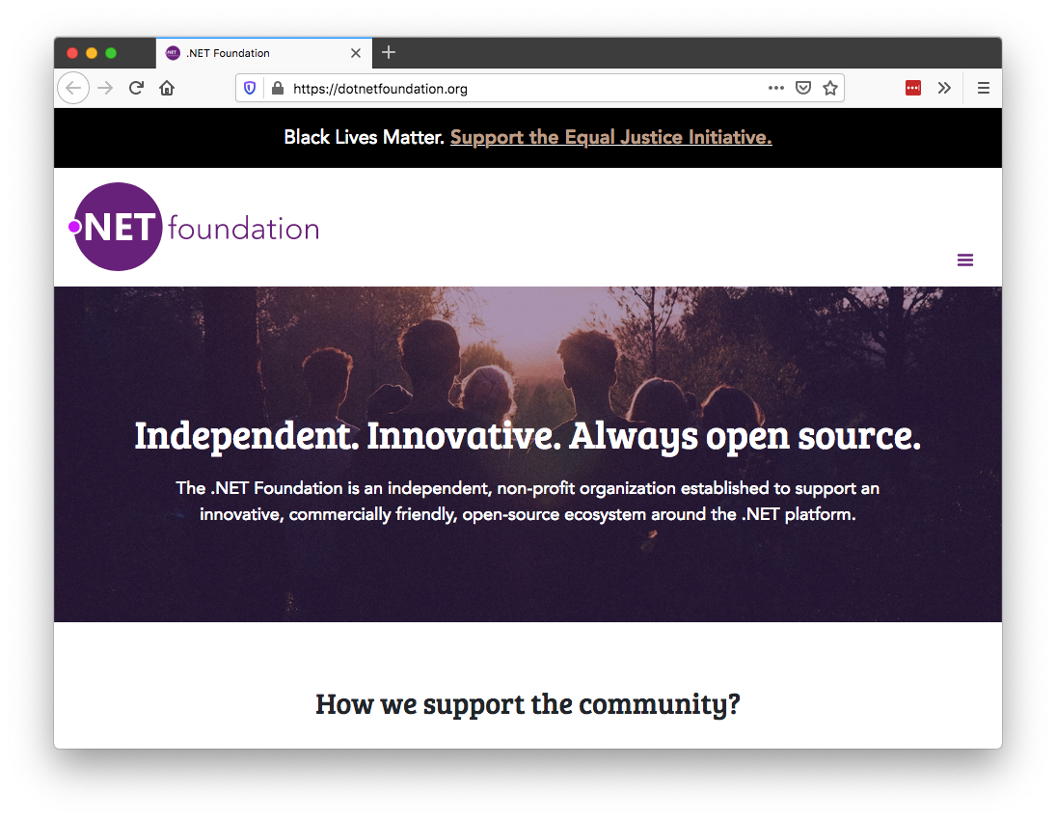
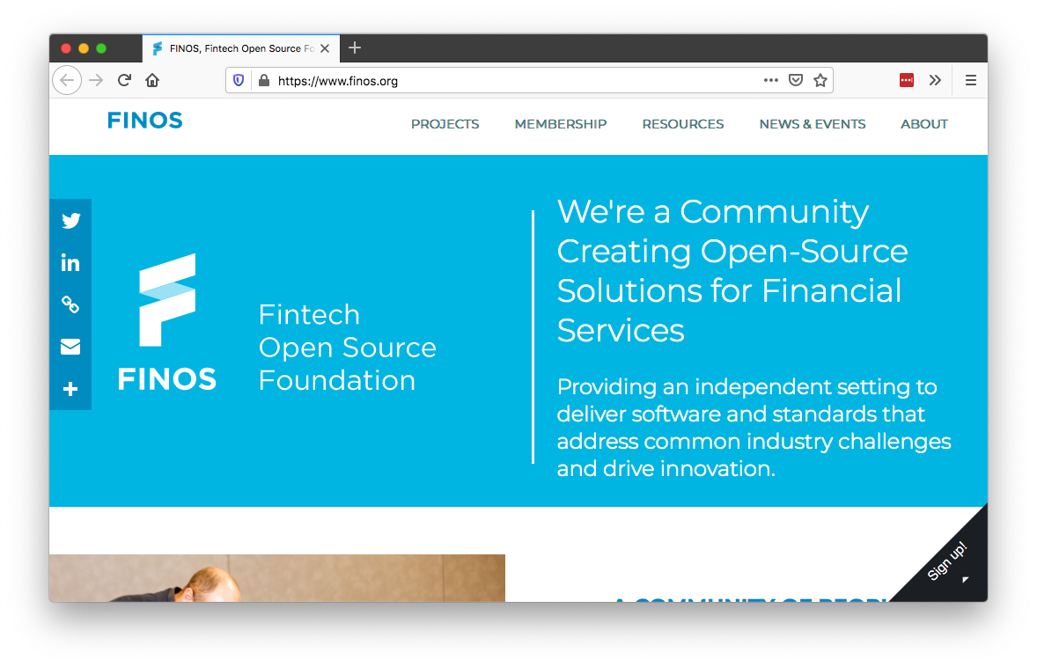

Slide 26
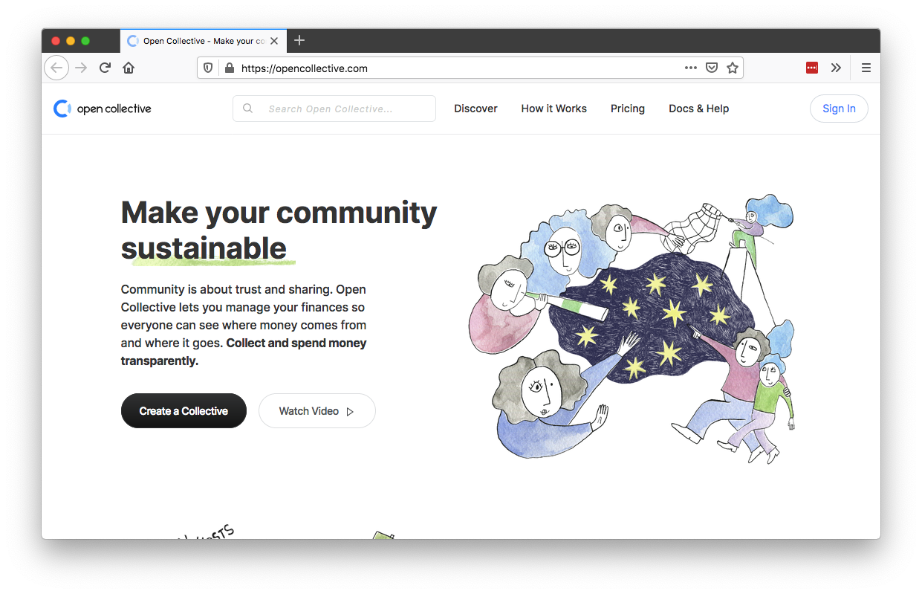
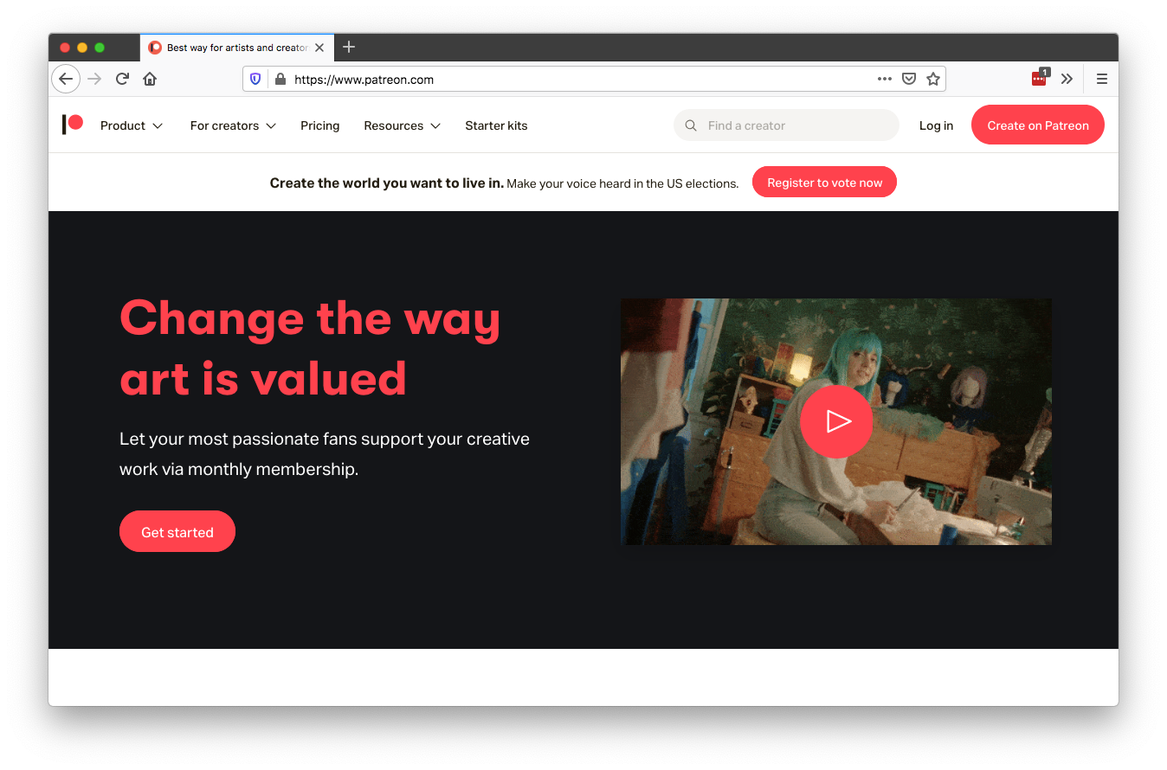
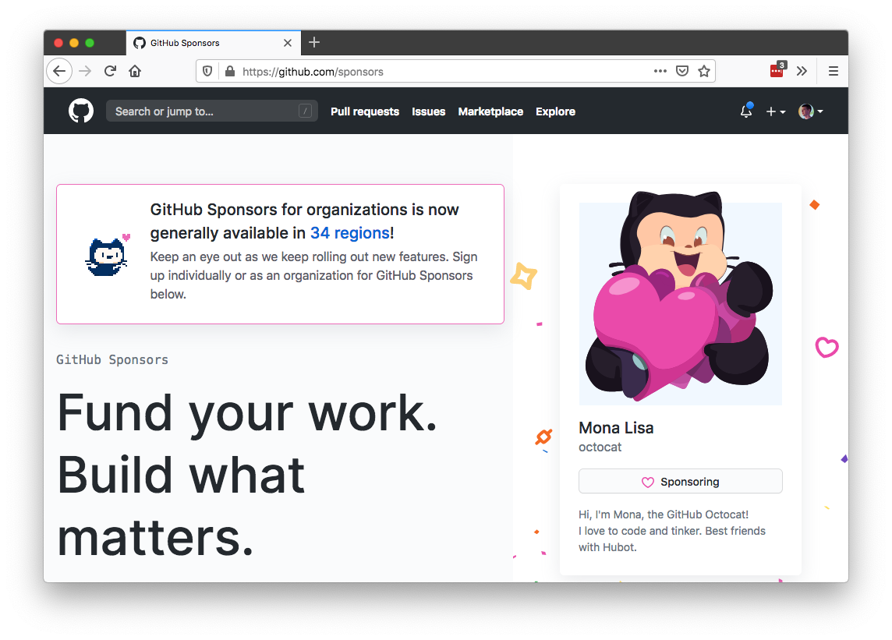
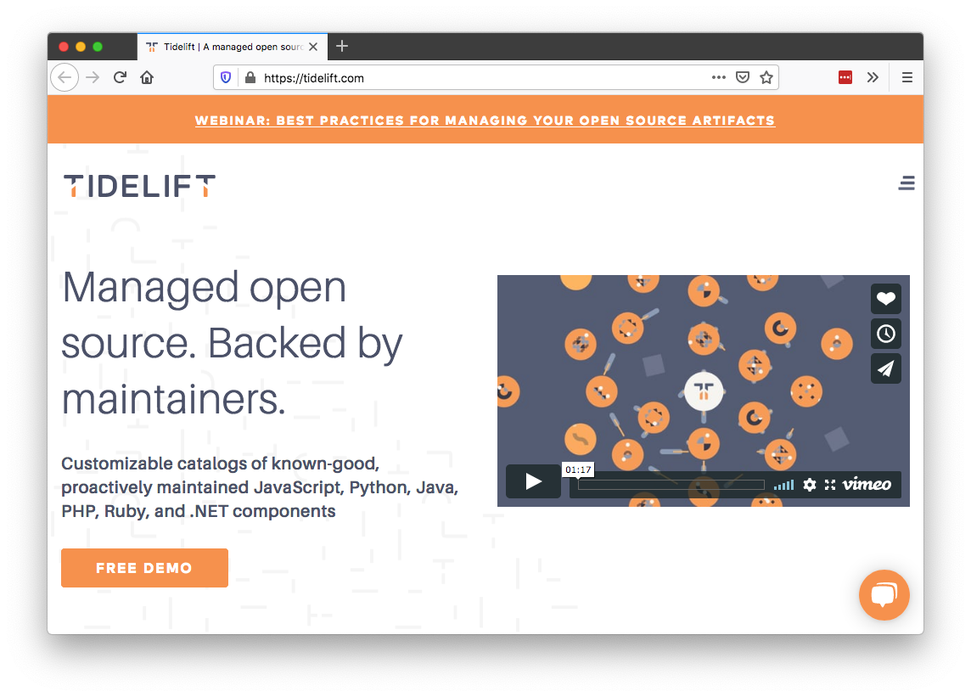

Slide 27
Notes:
When you pay for software you don’t have to worry about how the developers behind the software are getting paid, because the relationship is way more direct.
For example at KendoReact we make a suite of 80+ React UI components, and you pay us money if you want to use them—there’s no weird sponsorship or donation model.

Slide 28
Reasons to consider paid UI components
1) Guaranteed support
2) Long term piece of mind
3) Solving harder problems
4) More sane funding model
Notes:
time/benefit analysis
Because front-end developer’s time isn’t cheap, and there are some real time & cost saving by having things like...

Slide 29
Consider paid UI solutions
Notes:
Cost / benefit analysis

Slide 30
Thanks!
TJ VanToll | @tjvantoll
Learn more about KendoReact: https://kendoreact.com

